Slide 1
CISTRON
A Trajectory Based Single Cell Analysis Tool

Slide 2
Presented By Ishrat Jahan Emu BSSE0927

Slide 3
Supervised By
Sumon Ahmed
Assistant Professor
Institute of Information Technology, University of Dhaka

Slide 4
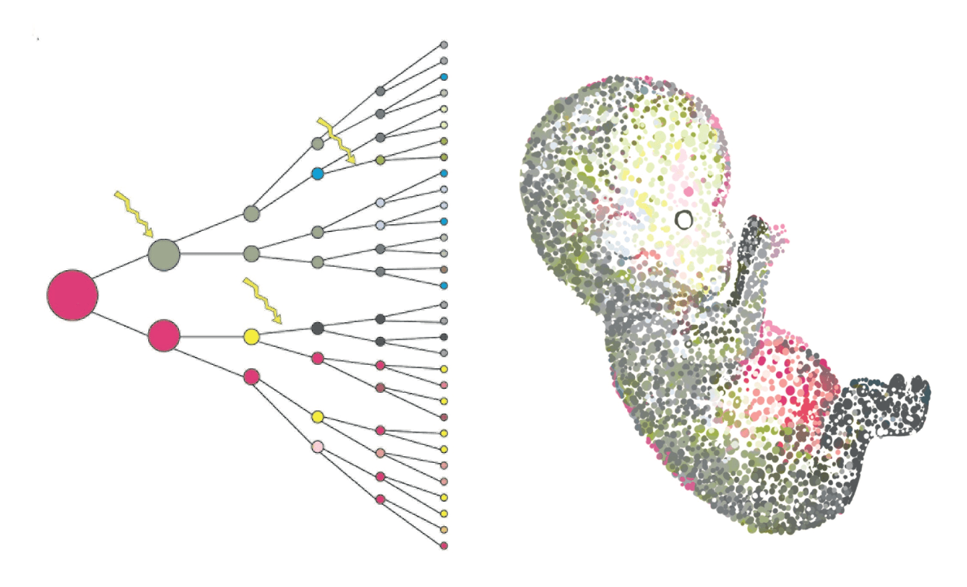
SINGLE CELL
All multicellular life starts from a
single cell.
With single cell genomics, we can explore in great detail what happens to the genome during the expansive processes of developing and sustaining life.

Slide 5
TRAJECTORY
Trajectory inference is a computational technique used in Single Cell analysis to determine the pattern of a dynamic process experienced by cells.
Some Trajectory Interfaces Methods: Slingshot , Monocle, TSCAN etc

Slide 6
MOTIVATION
Single cell Technology
Comparative Trajectory Analysis
Scope of Research

Slide 7
PROJECT DESCRIPTION
Cistron
A trajectory based single cell analysis tool is a standalone application.
This tool will take a normalised biological dataset as input.

Slide 8
PROJECT DESCRIPTION
It will show different trajectory interfaces with some common features of single cell technology
Being a standalone application ,all operating system users can use Cistron without any additional process.
Users can export the plot into JPG/PNG or PDF format for their further use.

Slide 9
Quality function deployment
Normal Requirement
Expected Requirement
Exciting Requirement

Slide 10
Normal Requirement
All plots can be downloaded from JPG/PNG format
Different Trajectory Methods
Can be used without Bioinformatics Expertise

Slide 11
Expected Requirement
Sample and cluster overview panels
Tables of most expressed genes and marker genes
Tables of enriched pathways for samples and clusters

Slide 12
Exciting Requirement
Interactive 2D and 3D Plot
Standalone Application

Slide 13
TIMELINE
week | 1st | 2nd | 3rd | 4th | 5th | 6th | 7th | 8th | 9th | 10th | 11th | 12th
Domain & Feasibility Study | X | X | X
Requirement Analysis & Design |  | X | X | X | X | X
Implementation & Testing |  |  | X | X | X | X | X | X | X | X
Deployment & Result Analysis |  |  |  |  |  |  |  |  | X | X | X | X
Documentation |  | X | X |  |  |  |  |  | X | X | X | X

Slide 14
THANK YOU

